Slide 1

18ECE340T- MACHINE PERCEPTION WITH COGNITION
UNIT-3
SESSION -3
Topics Covered: Representing structure using statistics of filter output
Reference Book
Computer and Machine Vision by E.R.Davies

Slide 2


Texture
Texture is a description of the spatial arrangement of color or
intensities in an image or a selected region of an image.
Structural approach: a set of texels in some regular or repeated pattern

Slide 3
The Case for Statistical Texture
Segmenting out texels is difficult or impossible in real images.
Numeric quantities or statistics that describe a texture can be
computed from the gray tones (or colors) alone.
This approach is less intuitive, but is computationally efficient.
It can be used for both classification and segmentation.

Slide 4
Texture analysis
Texture analysis is widely performed in the current time as it is considered as an intimate property of the surface.
It is widely used in the field of image processing, remote sensing applications, biomedical analysis, document processing, and so on.
Texture classification method include Gray Level Co occurrence Matrix (GLCM), Local binary pattern (LBP), autocorrelation function (ACF), and histogram pattern.
The detailed investigation on these methods suggests that GLCM is best for analyzing the surface texture.
Approaches to texture analysis are usually categorized into structural, statistical,
The advantage of the structural approach is that it provides a good symbolic description of the image; however, this feature is more useful for synthesis than analysis tasks.

Slide 5
statistical methods
The texture is an important descriptor of an image as it uses a spatial arrangement of gray values to analyze an image.
The statistical methods describe texture efficiently and are considered as one of the earliest methods for texture analysis of the image.
Based on the number of pixels statistical methods can be further classified as first-order statistics, second-order statistics, and high-order statistics.
First-order statistics do not provide sufficient information from the point of human visual perception.
First-order statistics include mean, variance, SD, skewness. The histogram is also considered as first-order statistics as it used the central mean value.

Slide 6
statistical methods
Second-order statistics use the neighborhood relationship between a pixel of interest (POI) and their neighborhood pixel.
The human beings are quite sensitive to second-order statistics as they provide sufficient information from the point of human visual perception which is the limitation of first-order statistics.
Second-order statistics include gray level cooccurrence matrix (GLCM), local binary pattern (LBP), and autocorrelation function (ACF) these methods are popularly used for describing the texture
. High-order statistics do not provide any information from a spectral and spatial point of view thus they are not considered for image interpretation.

Slide 7
Contd…
Approaches to texture analysis are usually categorised into structural, statistical,
The advantage of the structural approach is that it provides a good symbolic description of the image; however, this feature is more useful for synthesis than analysis tasks.

Slide 8
Some Simple Statistical Texture Measures
1. Edge Density and Direction
Use an edge detector as the first step in texture analysis.
The number of edge pixels in a fixed-size region tells us
how busy that region is.
The directions of the edges also help characterize the texture

Slide 9
Two Edge-based Texture Measures
1. Edgeness per unit area
2. Edge magnitude and direction histograms
Eedgeness = |{ p | gradient_magnitude(p) ≥ threshold}| / N
where N is the size of the unit area
Emagdir = ( Hmagnitude, Hdirection )
where these are the normalized histograms of gradient
magnitudes and gradient directions, respectively.

Slide 10
statistical approach
•The most famous statistical approach is the co-occurrence matrix.
•This was the result of the first approach to describe, and then classify, image texture .
• It remains popular today, by virtue of good performance.
•The co-occurrence matrix contains elements that are counts of the number of pixel pairs for specific brightness levels, when separated by some distance and at some relative inclination.
we obtain a square, symmetric, matrix whose dimensions equal the number of grey levels in the picture .

Slide 11
contd...
•In the co-occurrence matrix generation, the maximum distance was 1 pixel and the directions were set to select the four nearest neighbours of each point.
•Because the co-occurrence measures spatial relationships between brightness, as opposed to frequency content.
•This clearly gives alternative results.
•To generate results faster, the number of grey levels can be reduced by brightness scaling of the whole image, reducing the dimensions of the co-occurrence matrix, but this reduces discriminatory ability.

Slide 12
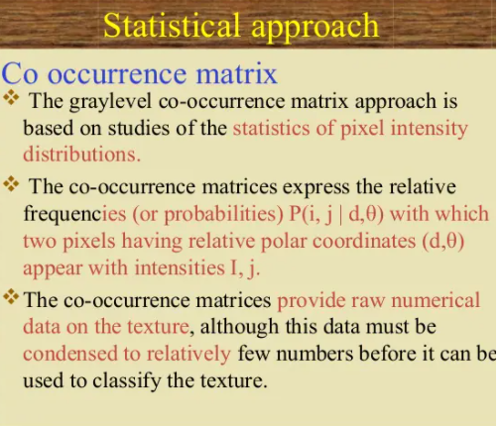

Slide 13
GLCM( Gray Level Co-occurrence Matrix)
The GLCM is a tabulation of how often different combinations of pixel brightness values (grey levels) occur in an image.
The GLCM is usually defined for a series of "second order" texture calculations.
Second order means they consider the relationship between groups of two pixels in the original image.
First order texture measures are statistics calculated from the original image values, like variance, and do not consider pixel relationships.
Third and higher order textures (considering the relationships among three or more pixels) are theoretically possible but not implemented due to calculation time and interpretation difficulty.

Slide 14
GLCM
GLCM texture considers the relation between two pixels at a time, called the reference and the neighbour pixel.
Let, the neighbour pixel is chosen to be the one to the east (right) of each reference pixel.
This can also be expressed as a (1,0) relation:
(i, j) -> (i+1, j).
Each pixel within the window becomes the reference pixel in turn, starting in the upper left corner and proceeding to the lower right.

Slide 15
Gray Level Co-occurrence Matrix
The gray level co-occurrence matrix approach is based on studies of the statistics of pixel intensity distributions.
The variance in pixel intensity values, single-pixel statistics do not provide rich enough descriptions of textures for practical applications.
It is natural to consider second-order statistics obtained by considering pairs of pixels in certain spatial relations to each other.
Co-occurrence matrices are used, which express the relative frequencies (or probabilities) with which two pixels having relative polar coordinates (d, θ) appear with intensities i, j.
The co-occurrence matrices provide raw numerical data on the texture, although this data must be condensed to relatively few numbers before it can be used to classify the texture.

Slide 16
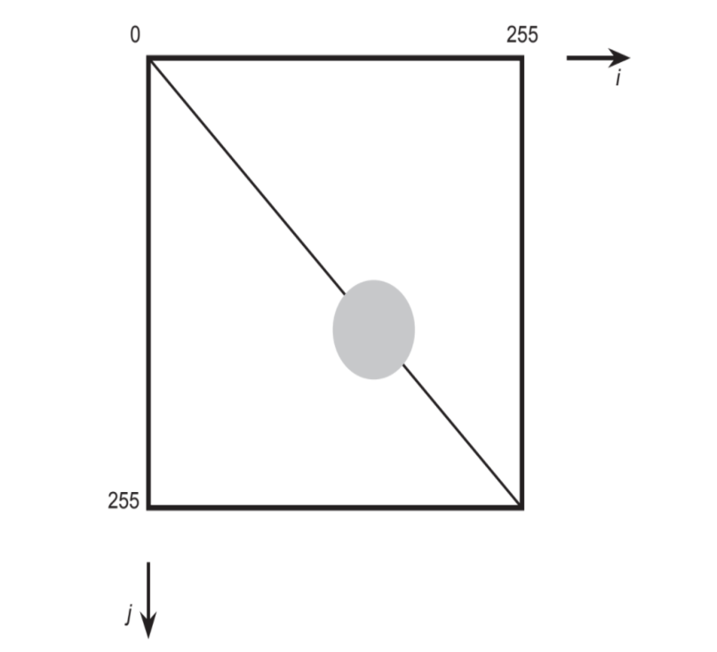
Operation of the GLCM,
It is nearly uniform image containing a single region .
The pixel intensities are subject to an approximately Gaussian noise distribution.
----Uniform distribution
The attention being on pairs of pixels at a constant vector distance d = (d, θ) from each other.

Slide 17
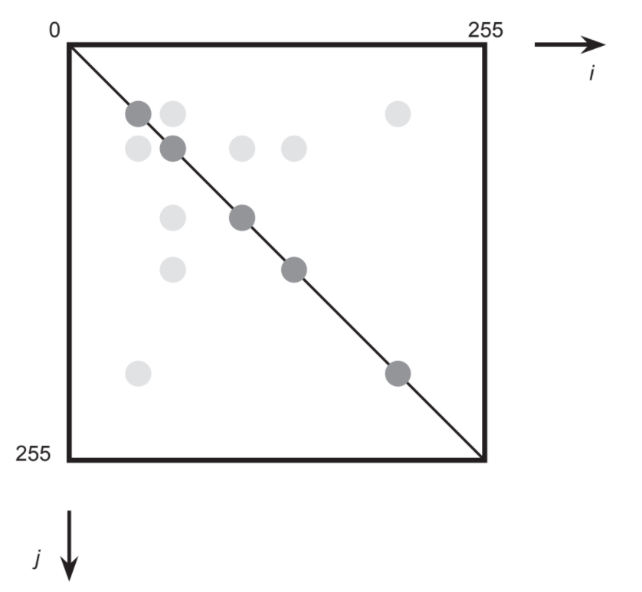
An almost noiseless image with several nearly uniform image regions.
The two pixels in each pair may correspond either to the same image regions or to different ones.
If d is small they will only correspond to adjacent image regions.

Slide 18
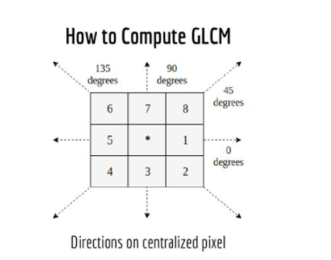
Computation of GLCM
Square Matrix-Same number of rows and column.
Different angle(0,45,90,135,180,180,225,270,315)
Symmetrical around diagonal.
Symmetry will be achieved it each pair is counted twice.
One is forward and one back is backward.
East and west---Horizontal
North and South--Vertical

Slide 19
Example
0 | 0 | 1 | 1
0 | 0 | 1 | 1
0 | 2 | 2 | 2
2 | 2 | 3 | 3
Compute the following.
(i)Coocurance Matrix
(ii)Symmetric GLCM
(iii) Normalized matrix
Pixel: 0,1,2,3
N=4
Size=4Χ4
D=1
Ɵ=Horizontal(zero degree)

Slide 20
Step1
i/j | 0 | 1 | 2 | 3
0 | #(0,0) | #(0,1) | #(0,2) | #(0,3)
1 | #(1,0) | #(1,1) | #(1,2) | #(1,3)
2 | #(2,0) | #(2,1) | #(2,2) | #(2,3)
3 | #(3,0) | #(3,1) | #(3,2) | #(3,3)
I,j | 0
0 | #(0,0)

Slide 21
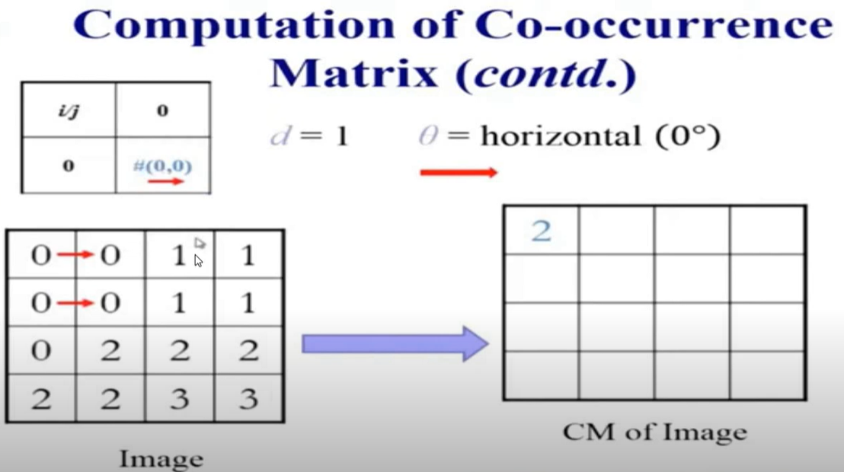

Slide 22
Coocurance Matrix
2 | 2 | 1 | 0
0 | 2 | 0 | 0
0 | 0 | 3 | 1
0 | 0 | 0 | 1

Slide 23
Symmetric GLCM
Co-occurnce matrix
Transpose matrix
2 | 2 | 1 | 0
0 | 2 | 0 | 0
0 | 0 | 3 | 1
0 | 0 | 0 | 1
2 | 0 | 0 | 0
2 | 2 | 0 | 0
1 | 0 | 3 | 0
0 | 0 | 1 | 1
Symmetric GLCM
4 | 2 | 1 | 0
2 | 4 | 0 | 0
1 | 0 | 6 | 1
0 | 0 | 1 | 2
Symmetric LCM=
Co-occurrence matrix
+
Transpose matrix

Slide 24

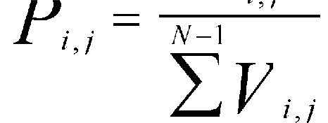

Expressing the GLCM
Symmetrical (1,0) GLCM
as a probability:
NPV>
0 1 2 3
RPV
0 | 4 | 2 | 1 | 0
1 | 2 | 4 | 0 | 0
2 | 1 | 0 | 6 | 1
3 | 0 | 0 | 1 | 2
This is the number of times this outcome occurs, divided by the total number of possible outcomes.
This process is called normalizing the matrix.
Normalization involves dividing by the sum of values.
.166 | .083 | .042 | 0
(4/24) | (2/24) | (1/24) | (0/24)
.083 | .166 | 0 | 0
.042 | 0 | .25 | .042
0 | 0 | .042 | .083

Slide 25
Co-occurrence Matrix Features
A co-occurrence matrix is a 2D array C in which
Both the rows and columns represent a set of possible
image values.
C (i,j) indicates how many times value i co-occurs with
value j in a particular spatial relationship d.
The spatial relationship is specified by a vector d = (dr,dc).
d

Slide 26
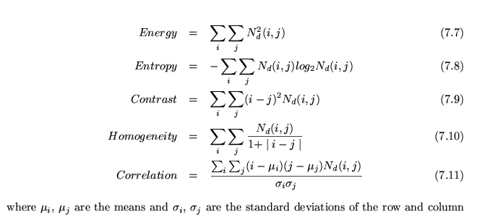
Co-occurrence Features
What do these measure?
sums.
Energy measures uniformity of the normalized matrix.

Slide 27
Local Binary Patterns
This texture descriptor observes the neibhouring pixels, converts them into a binary code and that code is transformed into a decimal number for further manipulation.
Let us take the following 3x3 neighborhood.
The center pixel - with value equal 5
5 - is taken as a reference and compared to its eight neighboring pixels:
Neighboring values that are larger than 5, are set to 1, neighboring values that are smaller, are set to 0

Slide 28

Local Binary Patterns
This results in a 8-bit code, which in turn can be converted into a decimal code.
This descriptor is constructed for each pixel of some window, sometimes even for the entire image.
The descriptor codes are then histogrammed: in case of the 8-bit code turned into a decimal code, that would result in a 256-dimensional vector.

Slide 29
Local Binary Pattern Measure
For each pixel p, create an 8-bit number b1 b2 b3 b4 b5 b6 b7 b8,
where bi = 0 if neighbor i has value less than or equal to p’s
value and 1 otherwise.
Represent the texture in the image (or a region) by the
histogram of these numbers.
1 2 3
100 101 103
40 50 80
50 60 90
4
5
8
1 1 1 1 1 1 0 0
7 6

